Slide 1


Welcome
To Our
Presentation

Slide 2

: Name Of Project :
Multi Tasking Converter
: Presented To :
Dr. Shaikh Muhammad Allayear
: Presented By :
Dr. Allayear
Name | ID
1. Kazi Jahidur Rahaman | 2015-3-60-012
2. Maksuda Akhter Meem | 2015-3-60-047

Slide 3
Case Study
This program will convert Temperature, Weight, Length And Currency from one unit to another unit…
Program will facilitate students in solving their problems related to above mentioned topics easily in a short time…
This program is designed in CODE BLOCKS…

Slide 4
Working Procedures
Welcome Page
Converter Selection
Unit Selection For Converting
Input Value To Be Converted
Converted Output
Convert Again?
Yes = ‘Y’
No = ‘N’
Want To Exit From Current Converter?
Yes = ‘Y’
No = ‘N’
Exit

Slide 5
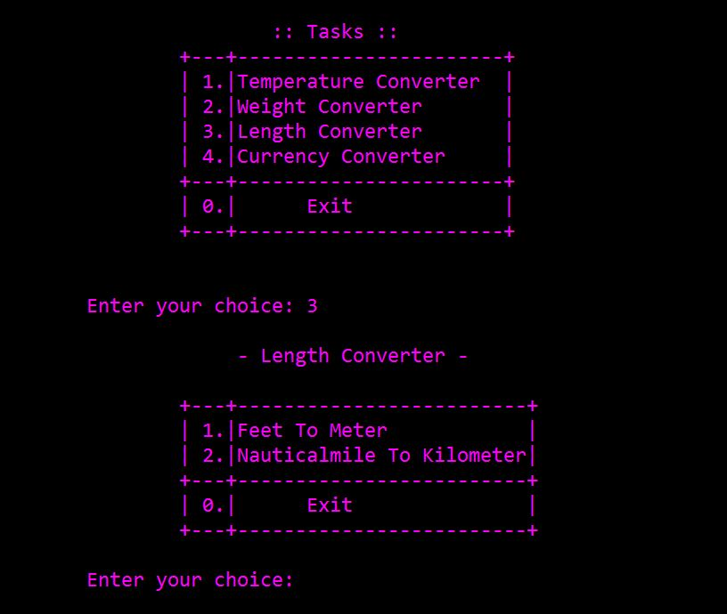
Output Screen

Slide 6
Contribution :
Jahid
Meem
Allayear Sir
Salahuddin Vai
Ehsan Vai
Refference :
http://www.tutorialspoint.com/cprogramming/index.htm

Slide 7


